Slide 1
Single Subject Design
Experimental Psychology

Slide 2
What is single-subject research?
Single-subject research: Involves examining the behavior or each of a small number of participants in detail
Group research: Involves studying a large number of participants
Single-subject research is different from:
  Qualitative research
  Case study: A detailed description of an individual case

Slide 3
Single-subject research
It is most strongly associated with the behaviorism, but can be used to study behavior from any perspective

Slide 4
Reversal design
Reversal design: Baseline, treatment, baseline (in that order)
  ABA design
  ABAB… design

Slide 5
Reversal design
During the first phase, A, a baseline is established for the dependent variable
Measured before any treatment is introduced and is therefore a kind of control condition

Slide 6
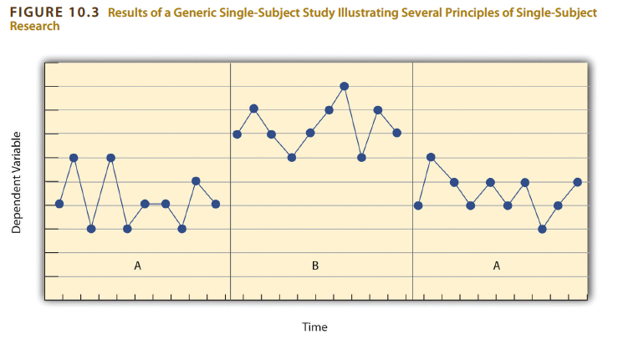
Reversal design

Slide 7
Your Turn
Design a simple single-subject study using a reversal design to answer a question about a behavior of interest.
Example: Does positive reinforcement increase a child’s tooth-brushing behavior?
Create a graph that displays the hypothetical results for the study you designed

Slide 8
Single-subject research:
Data analysis
Single-subject research relies heavily on visual inspection
  Level: The overall level of the dependent variable within a condition
  Trend: An increase or decrease in the independent variable over several observations
  Latency: The time between the change in conditions and the change in the dependent variable

Slide 9
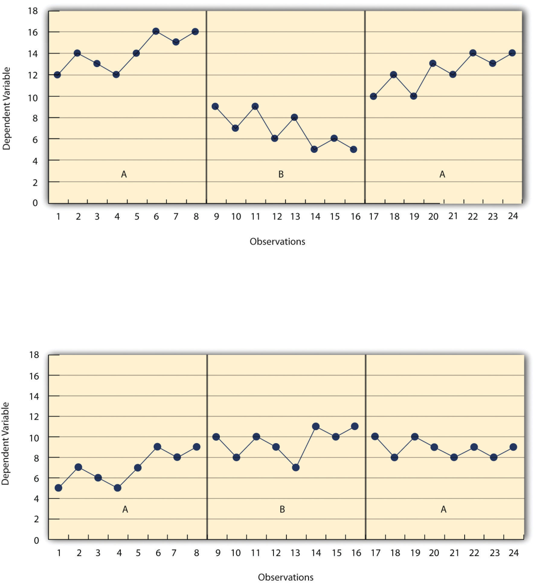
Single-subject research:
Data analysis

Slide 10
Reversal design
Multiple-treatment reversal design: Phases that introduce different treatments that are alternated
  ABCACB design

Slide 11
Reversal design
Potential problems:
  May be unethical to remove treatment
  Dependent variable may not return to baseline when the treatment is removed

Slide 12
Multiple-baseline design
Multiple-baseline design: Multiple baselines are established
  Different participants
  Different dependent variables
  Different contexts
Treatment is introduced at a different time for each baseline

Slide 13
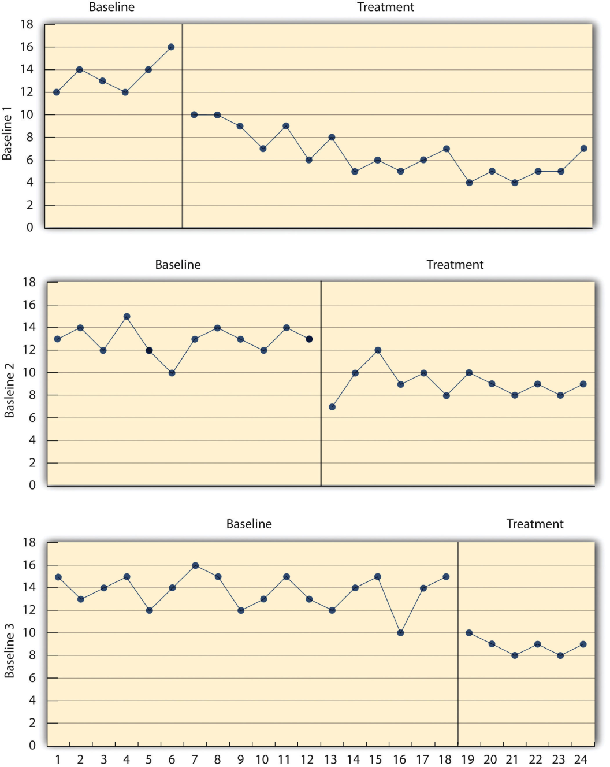
Multiple baseline design

Slide 14
Single-subject research:
Data analysis
Can use statistical procedures (becoming increasingly common)
Mean and standard deviation of the participants’ responses under each condition are computed and compared

Slide 15
Single-subject research:
Data analysis
Problems with data analysis
  Can we detect weak effects?
  Can be unreliable; may reach different conclusions about the same set of data
  The results of a visual inspection cannot be clearly and efficiently summarized or compared across studies

